Slide 1





GUI Development
By: Houari ZEGAI
@GeekHouari
&
@HouariZegai
HouariZegai14@gmail.com

Slide 2
What is JavaFx ?

Slide 3
JavaFx
GUI (Graphical User Interface)

Slide 4
What you should know ?

Slide 5
You should know
Java Programming
Classes and Objects in Java
Integrated Development Enviroments (IDE)
Optional: CSS (Cascading Style Sheet)

Slide 6
Real-world applications

Slide 7
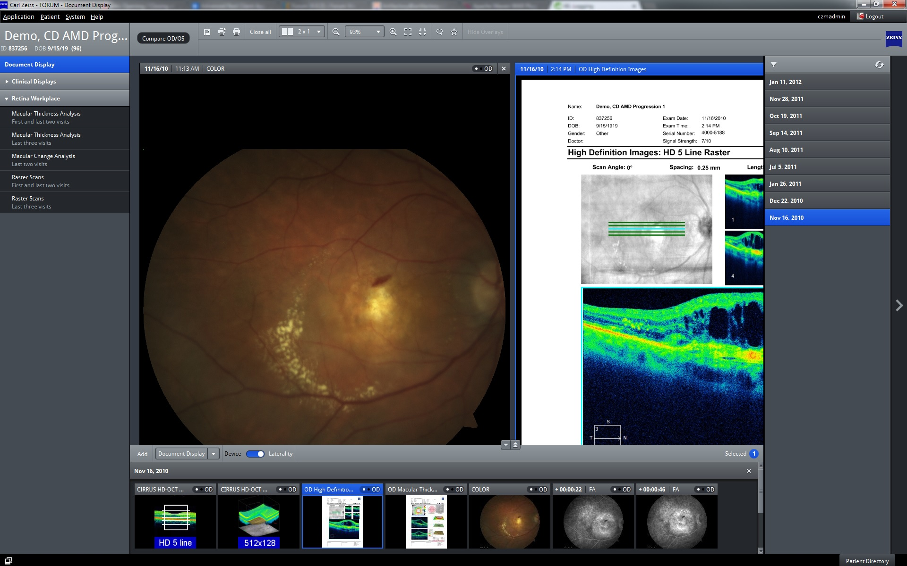
Real-world applications
1- Carl Zeiss Meditec AG
It is an archive software for clinical patient data in ophthalmology
Dev by: Saxonia Systems AG

Slide 8
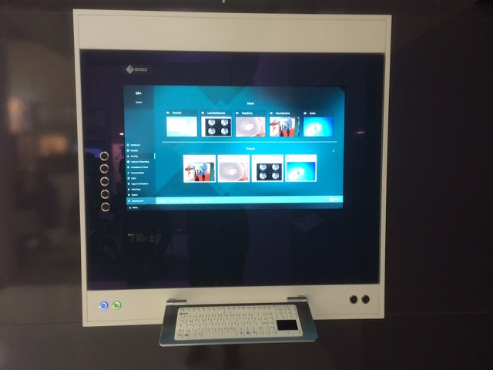

Real-world applications
2- CuratorOR Caliop
It is being installed in wall-mounted. used to look up patient data, to document the surgery, and to store the produced documents in the central hospital database.
Dev by: EIZO GmbH

Slide 9
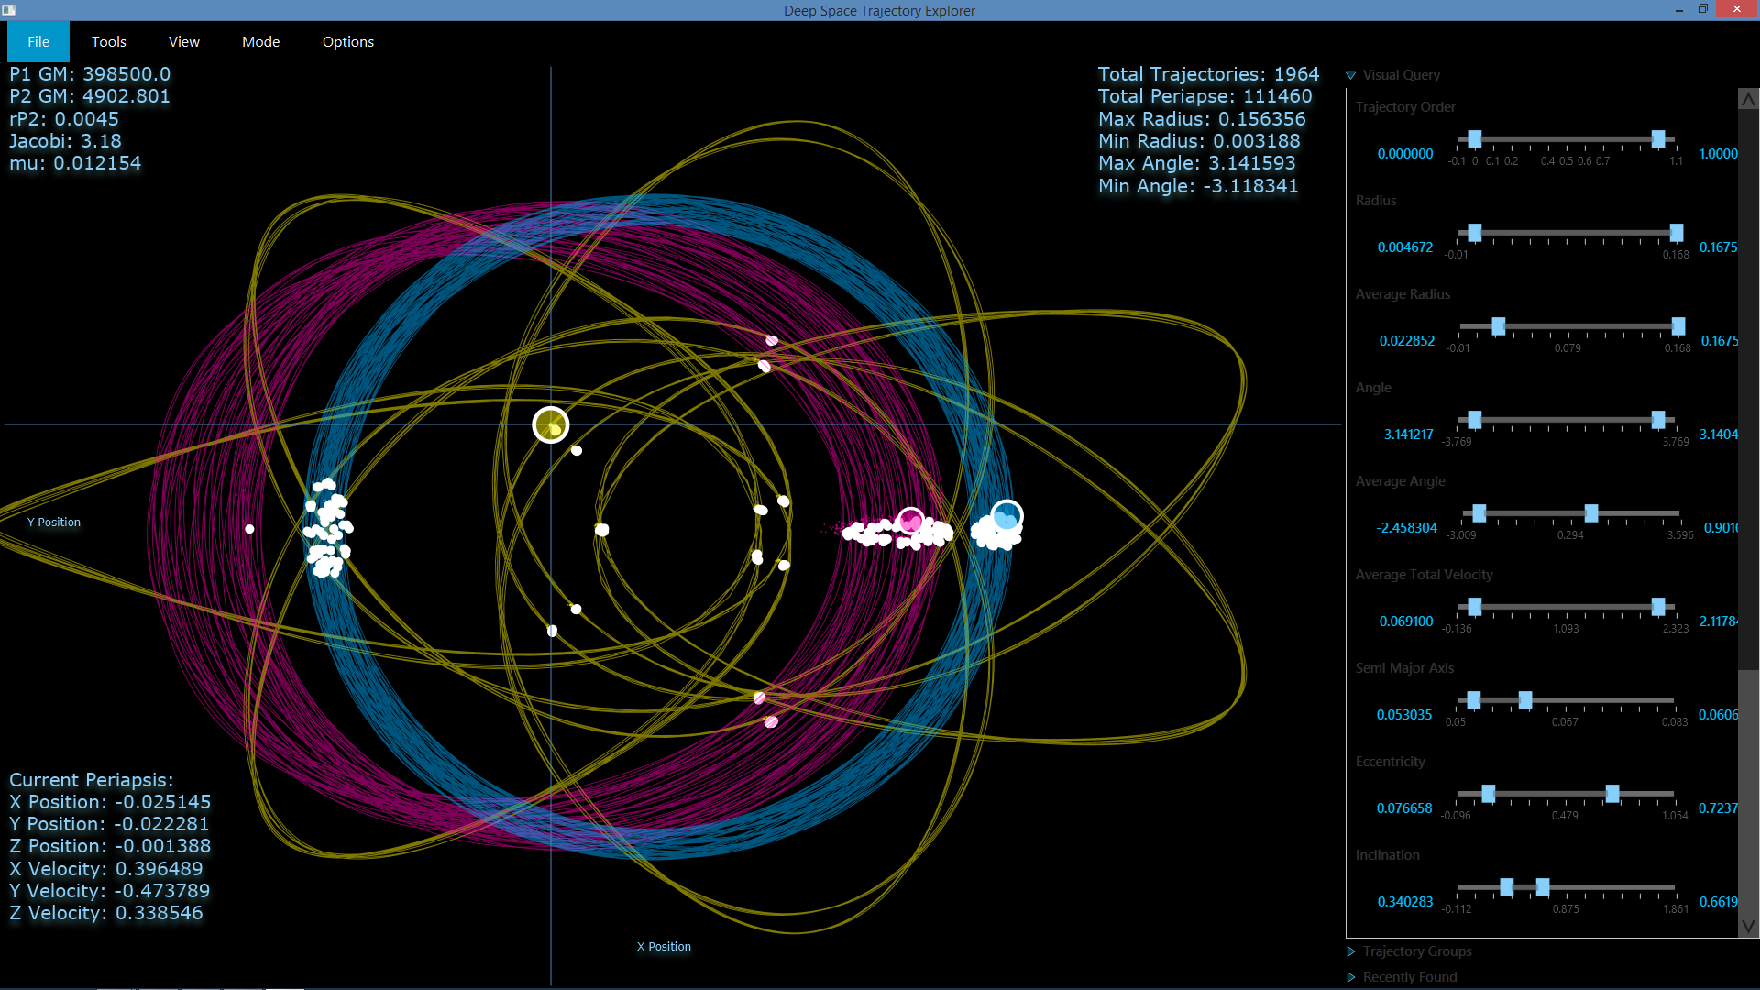
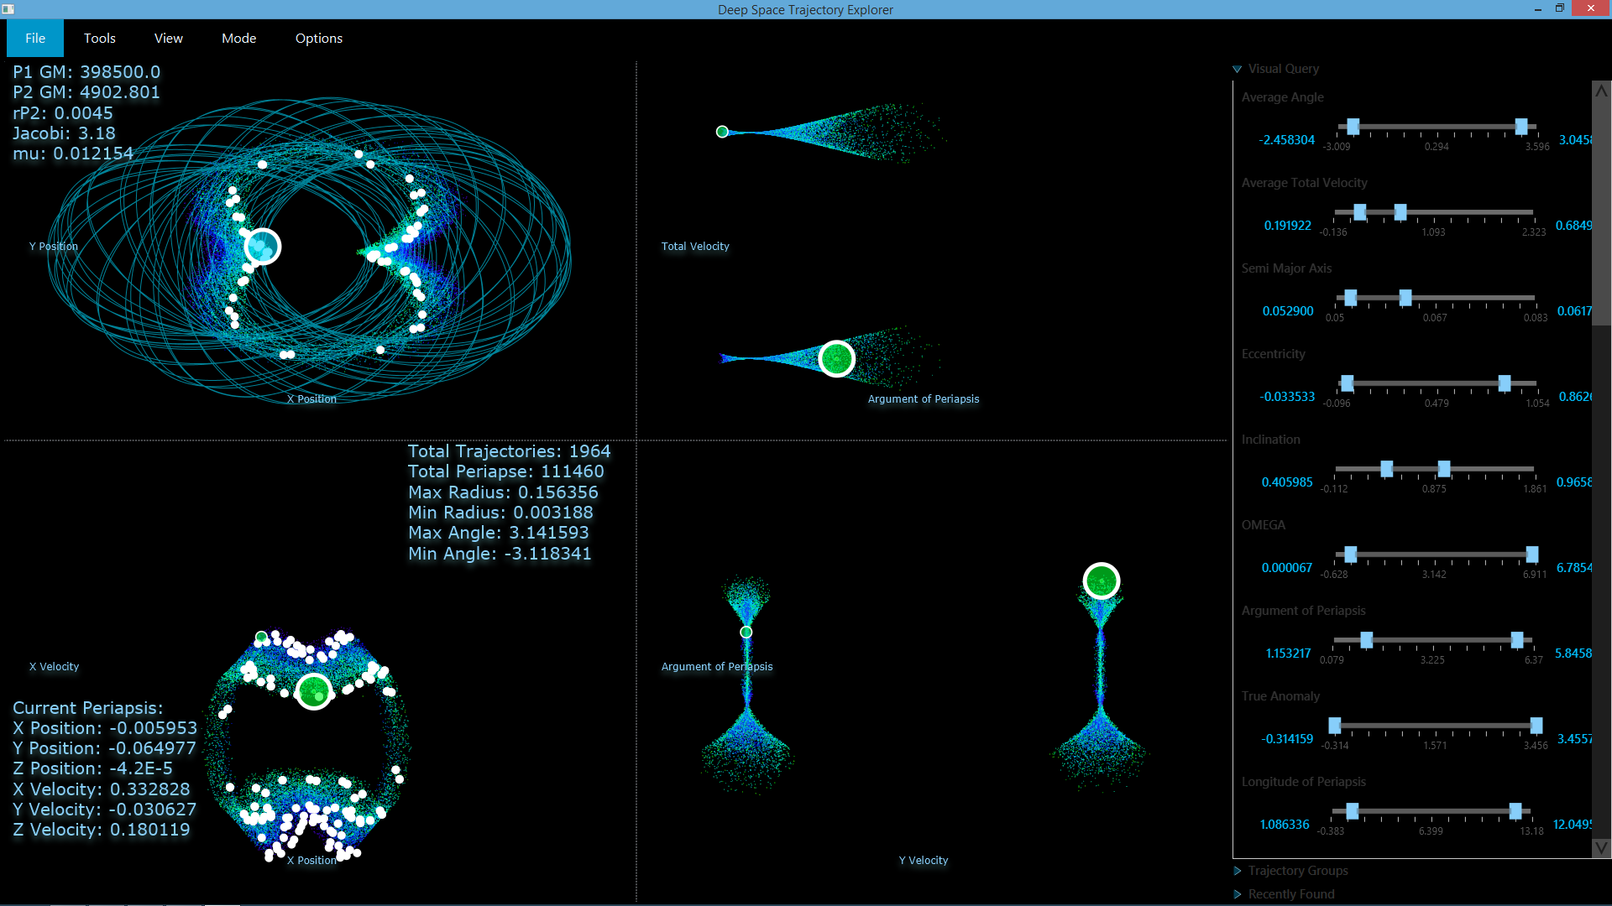
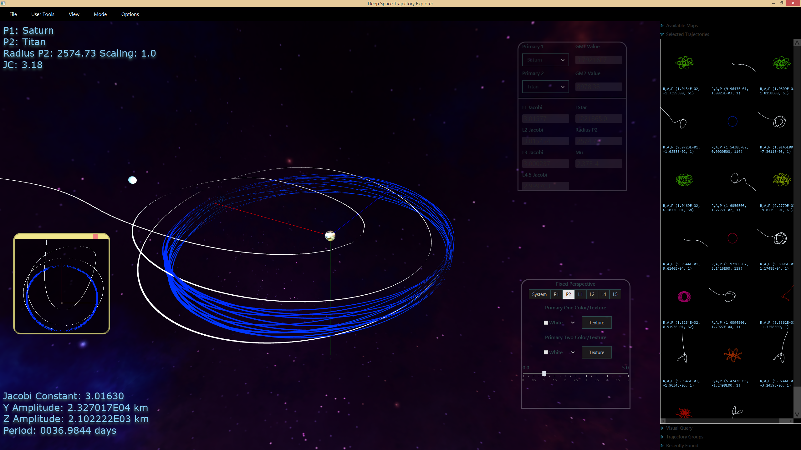
Real-world applications
3- Deep Space Trajectory
Explorer
Custom JavaFX tools have been built that provide high performance, interactive analysis for dimensional data sets.
Dev by: NASA

Slide 10
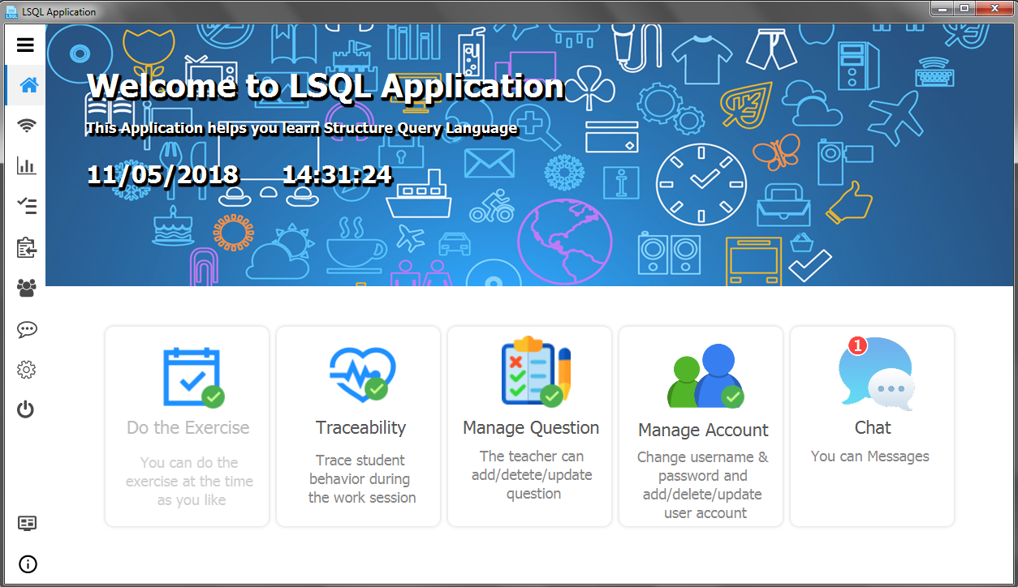
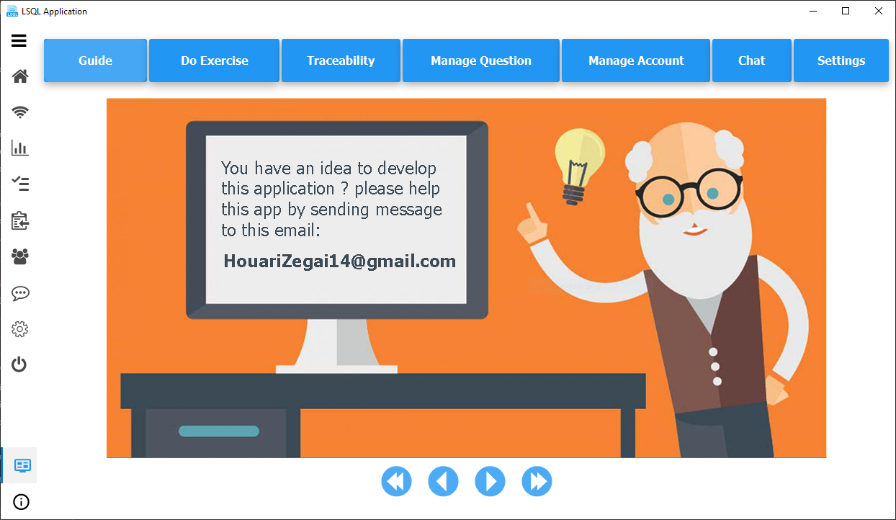
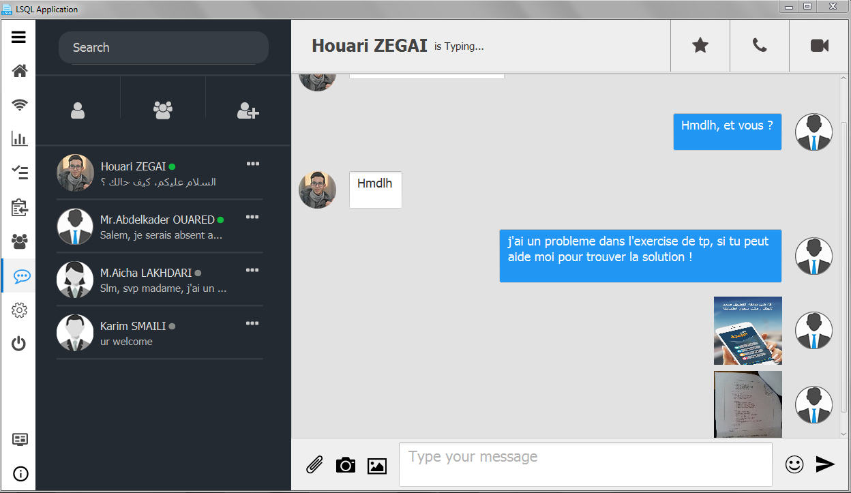
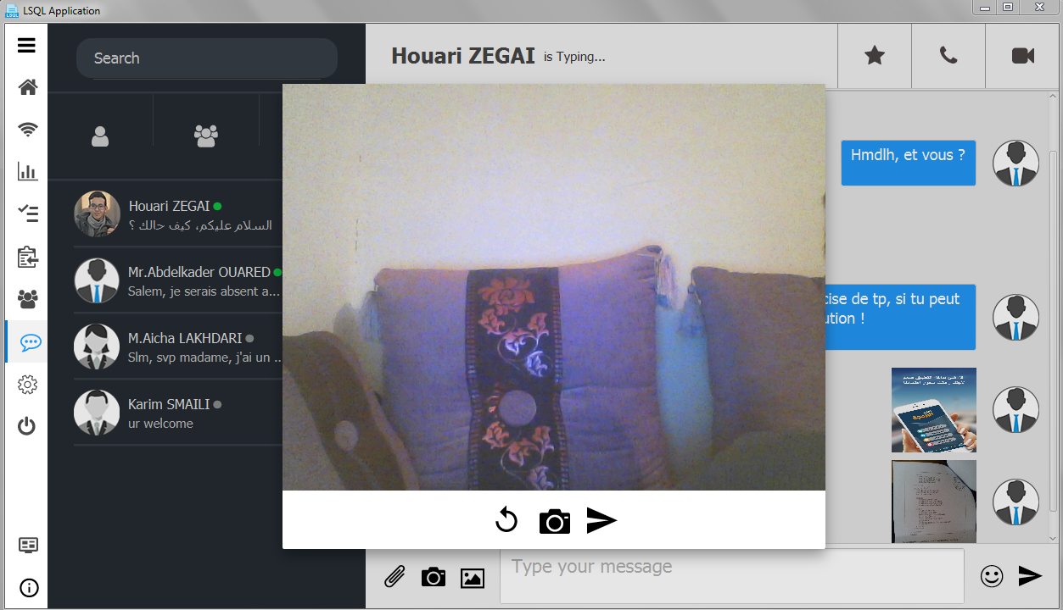
Real-world applications
4- Learn SQL App (LSQL)
Source: github.com/HouariZegai/LearnSQLApp
Dev by: Houari ZEGAI

Slide 11
JavaFx - Features
Has a library written as a Java API
Uses the MVC (Model View Controller) Design pattern
Supports the use of CSS and FXML
Separates presentation from application logic using FXML

Slide 12
JavaFx - Features
Integrates easily with existing Swing Applications (Compatible)
High Performance hardware
Installed with the JRE to make it available worldwide
….

Slide 13


Where can learn JavaFX
WebSites
Mohammed Al-Shawwa
Khalid ESSAADANI – خالد السعداني
TheNewBoston
Genuine Coder
KeepToo, Rashid Coder, Benny Coder, Houari Zegai, …
docs.oracle.com/javase/8/javafx/api
harmash.com/javafx
www.tutorialspoint.com/javafx
zetcode.com/gui/javafx
…

Slide 14
Basic information

Slide 15
Architecture of JavaFx
Stage
Button
TextField
Scene
Root Node
Label
ImageView
Nodes

Slide 16
JavaFx Scene Graph
Root Node
Its depicts hierarchical tree of nodes
Each elements is called a Node

Slide 17
JavaFX Scene Graph
The root node is the base node and has no parent nodes
Other nodes have one parent and zero or more children
Nodes have and id, style class, and bounding volume

Slide 18
JavaFX Nodes
Effects (blurs, shadow, …)
Opacity
Transforms
Event handlers
…

Slide 19
Layouts

Slide 20
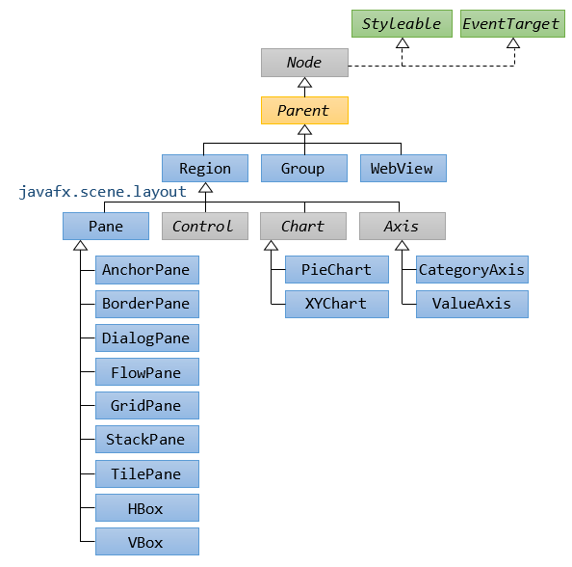
Layout
Class Parent
Layouts

Slide 21
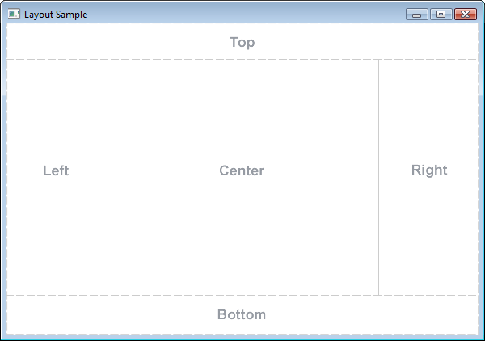
Layout
BorderPane

Slide 22
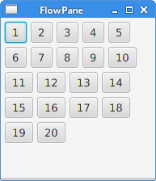
Layout
FlowPane

Slide 23
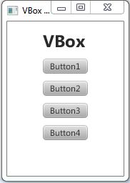
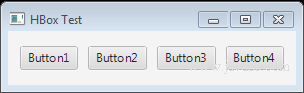
Layout
HBox
VBox

Slide 24
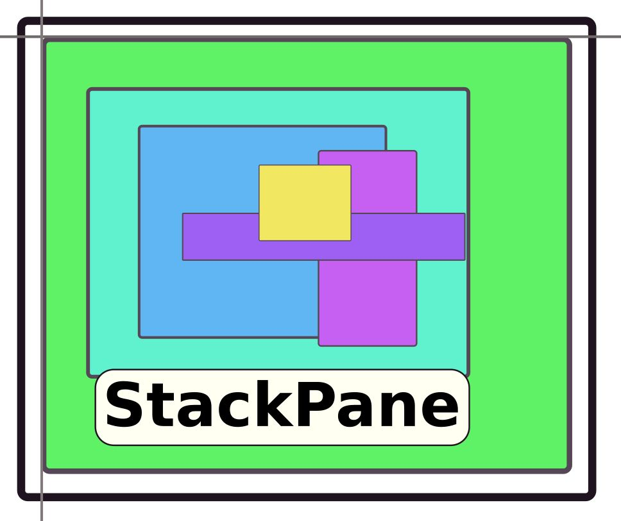
Layout
StackPane

Slide 25
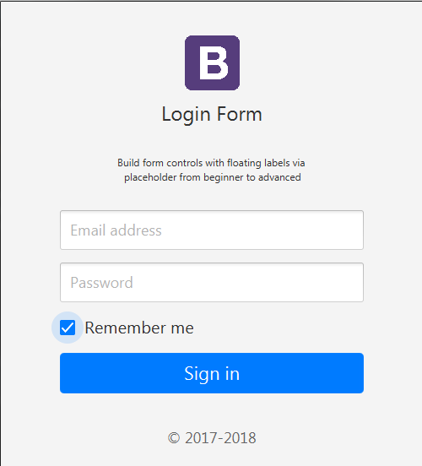
Example 1:
ImageView
VBox
Label
Text
TextField
PasswordField
CheckBox
Button
Label

Slide 26
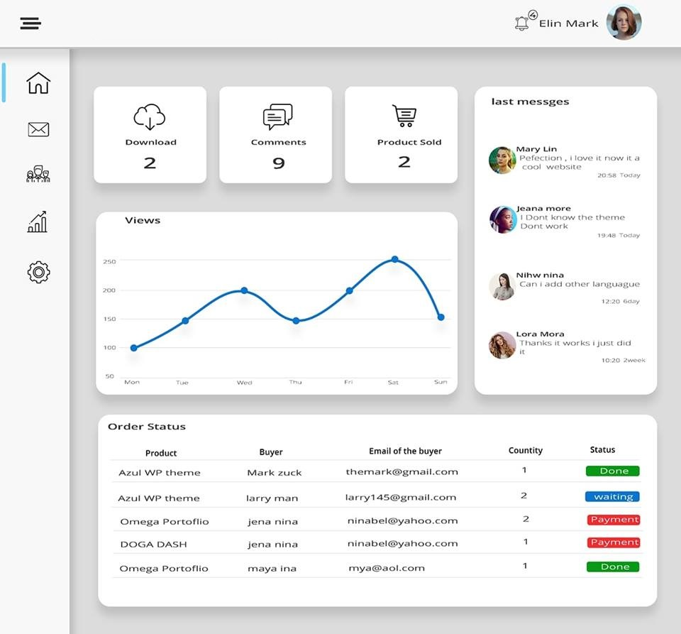
Example 2:
VBox
HBox
StackPane

Slide 27
Run first application

Slide 28
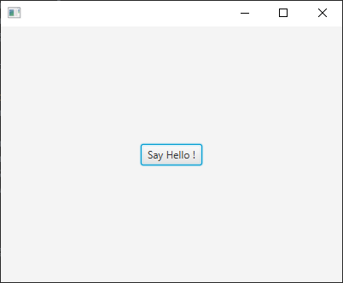
stage
public class FirstApp extends Application {
@Override
public void start(Stage stage) {
Button btn = new Button("Say Hello !");
VBox root = new VBox();
root.getChildren().add(btn);
Scene scene = new Scene(root, 400, 400);
stage.setScene(scene);
stage.show();
}
public static void main(String[] args) {
launch(args);
}
}
scene
root
btn

